Slide 1

Lecture 8 Discrete-time Fourier Transform
School of Computer Engineering and Science
Shanghai University
Instructor: Shengyu Duan , Weiwei Chen

Slide 2
Outline: Lecture 8: Discrete-time Fourier Transform
Discrete-time Fourier Transform
Fourier Transform Representation
Fourier Transform of Periodic Signal
Fourier Transform Properties
Examples
Duality

Slide 3
Outline: Lecture 8: Discrete-time Fourier Transform
Discrete-time Fourier Transform
Fourier Transform Representation
Fourier Transform of Periodic Signal
Fourier Transform Properties
Examples
Duality

Slide 4
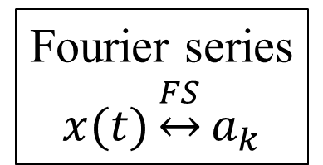
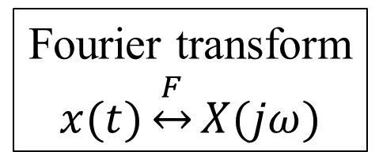
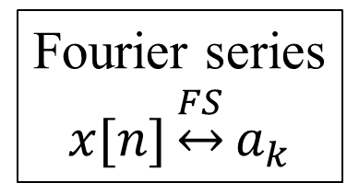
Discrete-time Fourier Transform
Periodicity
Periodic
Aperiodic
Fourier series
$$x(t)\underset{↔}{FS}a_{k}$$
Fourier transform
$$x(t)\underset{↔}{F}X(jω)$$
Continuous
Continuity
Fourier series
$$x[n]\underset{↔}{FS}a_{k}$$
Discrete
???

Slide 5
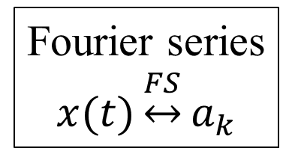
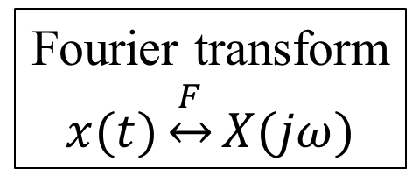
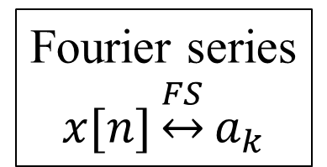
Discrete-time Fourier Transform
Periodicity
Periodic
Aperiodic
Fourier series
$$x(t)\underset{↔}{FS}a_{k}$$
Fourier transform
$$x(t)\underset{↔}{F}X(jω)$$
Continuous
Continuity
Fourier series
$$x[n]\underset{↔}{FS}a_{k}$$
Discrete
???
Periodic time-domain signal$↔$Discrete frequency-domain signal

Slide 6
Discrete-time Fourier Transform
Periodicity
Periodic
Aperiodic
Fourier series
$$x(t)\underset{↔}{FS}a_{k}$$
Fourier transform
$$x(t)\underset{↔}{F}X(jω)$$
Continuous
Continuity
Fourier series
$$x[n]\underset{↔}{FS}a_{k}$$
Discrete
???
Continuous time-domain signal$↔$Aperiodic frequency-domain signal

Slide 7
Discrete-time Fourier Transform
Periodicity
Periodic
Aperiodic
Fourier series
$$x(t)\underset{↔}{FS}a_{k}$$
Fourier transform
$$x(t)\underset{↔}{F}X(jω)$$
Continuous
Continuity
Fourier series
$$x[n]\underset{↔}{FS}a_{k}$$
Continuous and periodic
frequency-domain signal?
Discrete

Slide 8
Discrete-time Fourier Transform
In the previous lecture, we show a discrete-time periodic signal can be represented by a Fourier series, producing the spectral in frequency domain.
An aperiodic signal can be considered as a periodic signal, the period of which is extremely large, e.g., infinity.

Slide 9
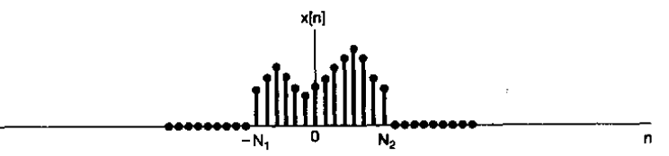

Fourier Transform Representation
From Fourier series to Fourier transform
The following signal, $x[n],$ is an aperiodic signal:

Slide 10
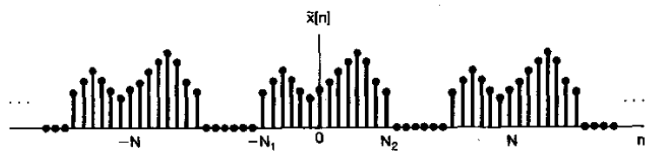

Fourier Transform Representation
From Fourier series to Fourier transform
Assume $x[n]$ is repeated for every period of N$(N→∞)$, as $\tilde{x}[n]$

Slide 11

Fourier Transform Representation
From Fourier series to Fourier transform
Fourier series representation:
$$\tilde{x}[n]=\sum_{k=\left\langle N\right\rangle }{a_{k}e^{jkω_{0}n}}$$
$$a_{k}=\frac{1}{N}\sum_{n=\left\langle N\right\rangle }{\tilde{x}[n]e^{−jkω_{0}n}}$$

Slide 12

Fourier Transform Representation
From Fourier series to Fourier transform
In the time of [$−N_{1},N_{2}$], $\tilde{x}[n]=x[n]$
$$a_{k}=\frac{1}{N}\sum_{n=\left\langle N\right\rangle }{\tilde{x}[n]e^{−jkω_{0}n}}$$
$$=\frac{1}{N}\sum_{n=−N_{1}}^{N_{2}}{x [n]e^{−jkω_{0}n}}=\frac{1}{N}\sum_{n=−∞}^{∞}{x [n]e^{−jkω_{0}n}}$$
$${Na}_{k}=\sum_{n=−∞}^{∞}{x [n]e^{−jkω_{0}n}}$$

Slide 13

Fourier Transform Representation
From Fourier series to Fourier transform
$${Na}_{k}=\sum_{n=−∞}^{∞}{x [n]e^{−jkω_{0}n}}$$
Define $X\left(e^{jω}\right)=\sum_{n=−∞}^{∞}{x [n]e^{−jωn}}$
$${Na}_{k}=X\left(e^{jω}\right)|_{ω=kω_{0}}=\sum_{n=−∞}^{∞}{x [n]e^{−jωn}}|_{ω=kω_{0}}$$

Slide 14
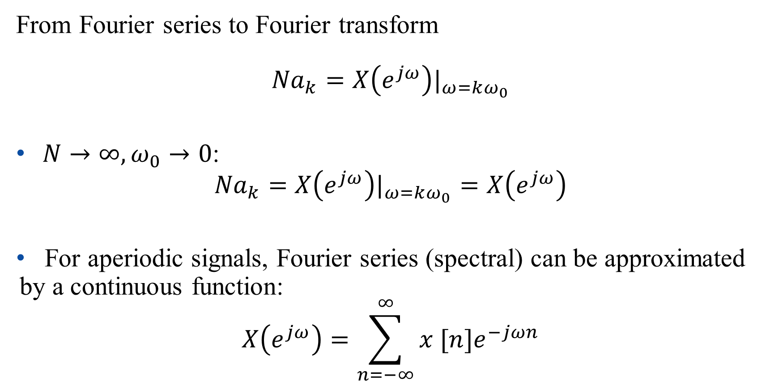
Fourier Transform Representation
From Fourier series to Fourier transform
$${Na}_{k}=X\left(e^{jω}\right)|_{ω=kω_{0}}$$
$N→∞,ω_{0}→0$:
$${Na}_{k}=X\left(e^{jω}\right)|_{ω=kω_{0}}=X\left(e^{jω}\right)$$
For aperiodic signals, Fourier series (spectral) can be approximated by a continuous function:
$$X\left(e^{jω}\right)=\sum_{n=−∞}^{∞}{x [n]e^{−jωn}}$$

Slide 15

Fourier Transform Representation
$$\tilde{x}[n]=\sum_{k=\left\langle N\right\rangle }{a_{k}e^{jkω_{0}n}},{ Na}_{k}=X\left(e^{jω}\right)|_{ω=kω_{0}}$$
$$\tilde{x}\left(t\right)=\sum_{k=\left\langle N\right\rangle }{\frac{1}{N}X(e^{jkω_{0}})e^{jkω_{0}n}}$$
$$=\frac{1}{2π}\sum_{k=\left\langle N\right\rangle }{X(e^{jkω_{0}})e^{jkω_{0}n}ω_{0}}$$

Slide 16

Fourier Transform Representation
$$\tilde{x}[n]=\frac{1}{2π}\sum_{k=\left\langle N\right\rangle }{X(e^{jkω_{0}})e^{jkω_{0}n}ω_{0}}$$
In the time of [$0,N−1$] ($N→∞$: [$0,∞$] ), $\tilde{x}[n]=x[n]$
$$x[n]=\frac{1}{2π}\sum_{k=\left\langle N\right\rangle }{X(e^{jkω_{0}})e^{jkω_{0}n}ω_{0}}$$

Slide 17
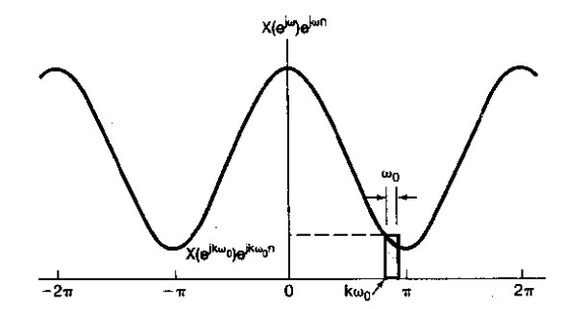

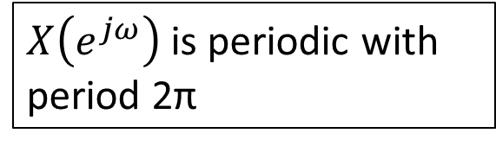
Fourier Transform Representation
$$x[n]=\frac{1}{2π}\sum_{k=\left\langle N\right\rangle }{X(e^{jkω_{0}})e^{jkω_{0}n}ω_{0}}$$
$$x[n]=\frac{1}{2π}\int_{2π}{X\left(e^{jω}\right)e^{jωn}dω}$$
$X\left(e^{jω}\right)$ is periodic with period 2π

Slide 18
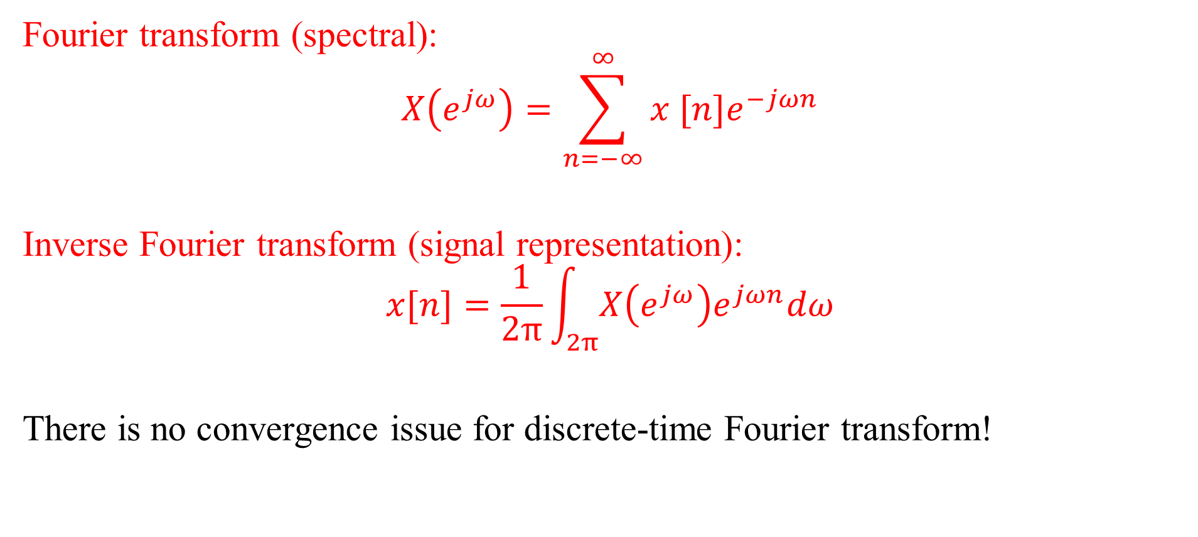
Fourier Transform Representation
Fourier transform (spectral):
$$X\left(e^{jω}\right)=\sum_{n=−∞}^{∞}{x [n]e^{−jωn}}$$
Inverse Fourier transform (signal representation):
$$x[n]=\frac{1}{2π}\int_{2π}{X\left(e^{jω}\right)e^{jωn}dω}$$
There is no convergence issue for discrete-time Fourier transform!

Slide 19
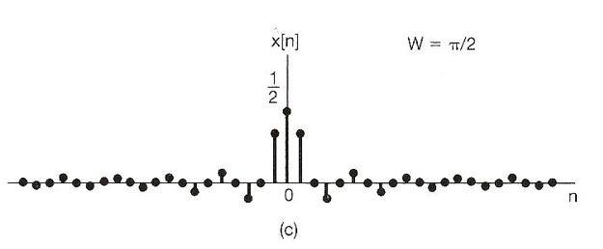
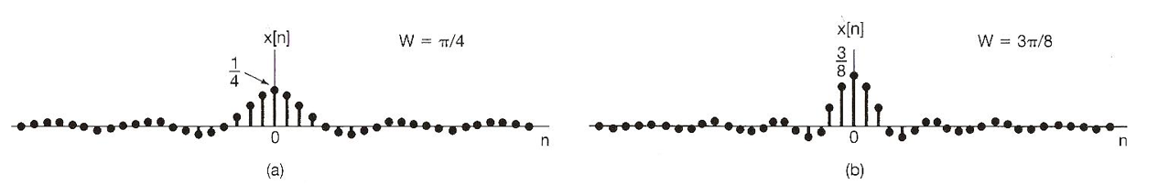
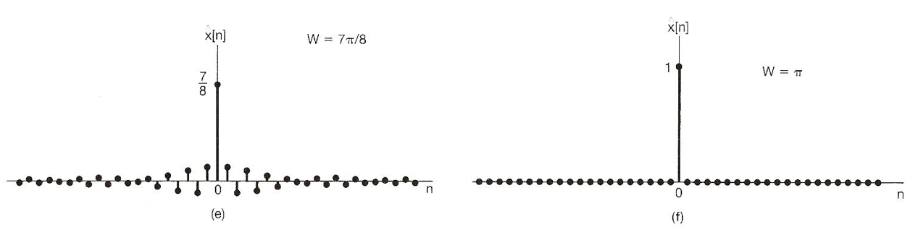
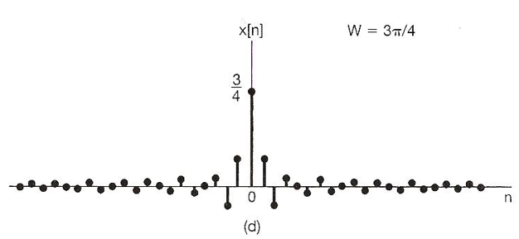

Fourier Transform Representation
Example 5.4, p.260 of textbook
$$x\left[n\right]=δ\left[n\right], X\left(e^{jω}\right)=1$$
Assume $\hat{x}\left[n\right]=\frac{1}{2π}\int_{−W}^{W}{e^{jωn}dω}=\frac{sinWn}{πn}$, and increase W from 0 to π:

Slide 20
Outline: Lecture 8: Discrete-time Fourier Transform
Discrete-time Fourier Transform
Fourier Transform Representation
Fourier Transform of Periodic Signal
Fourier Transform Properties
Examples
Duality

Slide 21

Fourier Transform of Periodic Signal
For a periodic signal, we have the Fourier series representation:
$$x[n]=\sum_{k=\left\langle N\right\rangle }{a_{k}e^{jkω_{0}n}}$$
Let us firstly consider the Fourier transform for a complex exponential: $e^{jkω_{0}n}$.

Slide 22
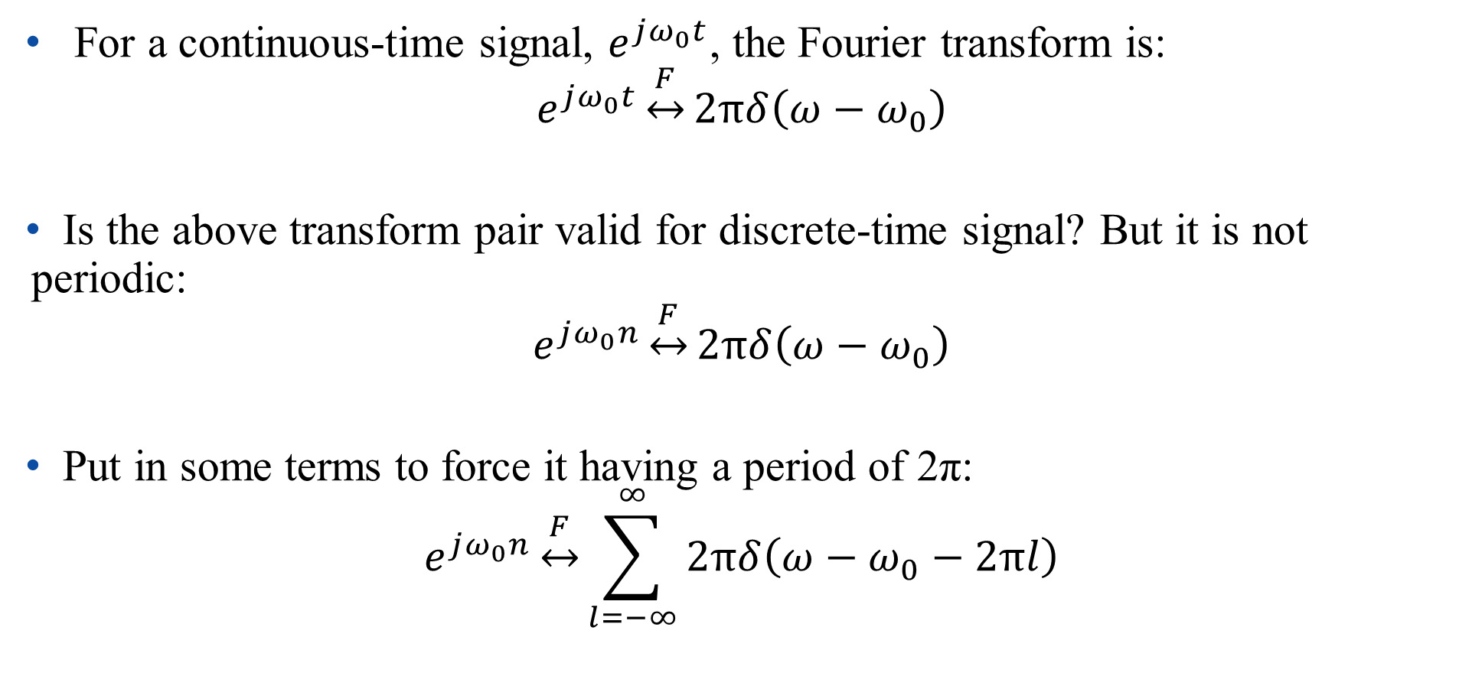
Fourier Transform of Periodic Signal
For a continuous-time signal, $e^{jω_{0}t}$, the Fourier transform is:
$$e^{jω_{0}t}\underset{↔}{F}2πδ\left(ω−ω_{0}\right)$$
Is the above transform pair valid for discrete-time signal? But it is not periodic:
$$e^{jω_{0}n}\underset{↔}{F}2πδ\left(ω−ω_{0}\right)$$
Put in some terms to force it having a period of 2π:
$$e^{jω_{0}n}\underset{↔}{F}\sum_{l=−∞}^{∞}{2πδ\left(ω−ω_{0}−2πl\right)}$$

Slide 23
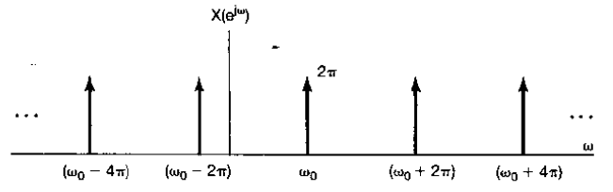

Fourier Transform of Periodic Signal
$$x\left[n\right]=e^{jω_{0}n}\underset{↔}{F}X\left(e^{jω}\right)=\sum_{l=−∞}^{∞}{2πδ\left(ω−ω_{0}−2πl\right)}$$

Slide 24

Fourier Transform of Periodic Signal
$$x\left[n\right]=e^{jω_{0}n}\underset{↔}{F}X\left(e^{jω}\right)=\sum_{l=−∞}^{∞}{2πδ\left(ω−ω_{0}−2πl\right)}$$
Proof:
$x[n]=\frac{1}{2π}\int_{2π}{X\left(e^{jω}\right)e^{jωn}dω}$
$$=\frac{1}{2π}\int_{2π}{\sum_{l=−∞}^{∞}{2πδ\left(ω−ω_{0}−2πl\right)}e^{jωn}dω}$$
$$=\frac{1}{2π}\int_{2π}{2πδ\left(ω−ω_{0}\right)e^{jωn}dω}=e^{jω_{0}n}$$

Slide 25
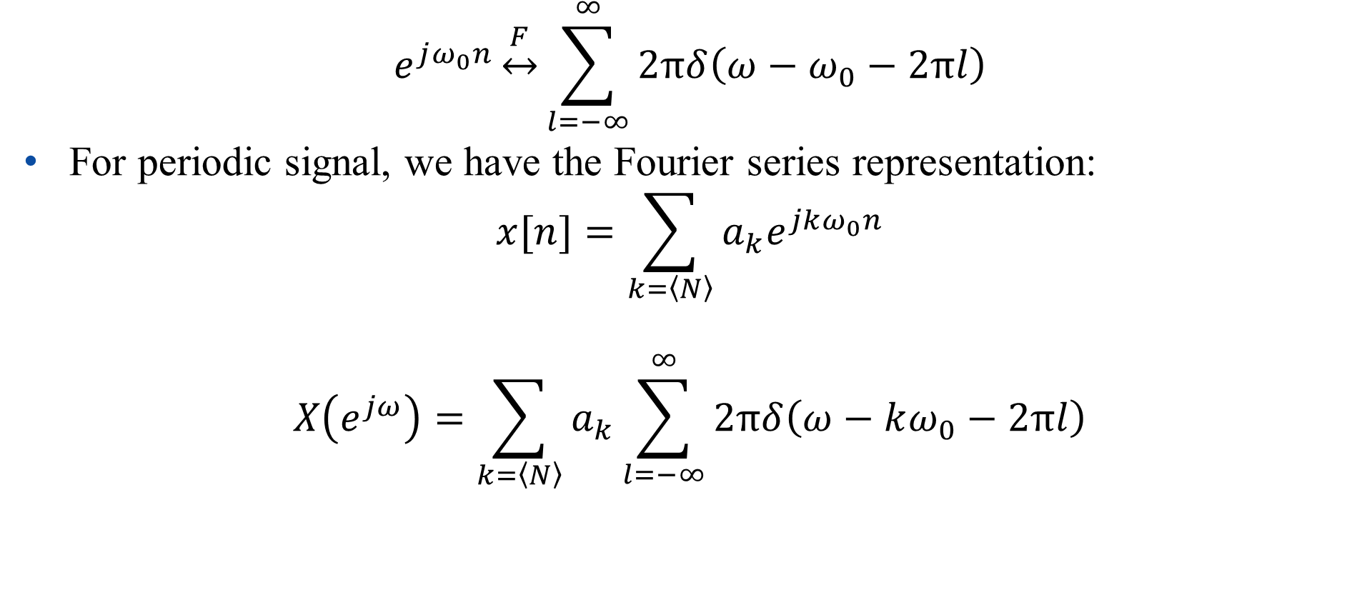
Fourier Transform of Periodic Signal
$$e^{jω_{0}n}\underset{↔}{F}\sum_{l=−∞}^{∞}{2πδ\left(ω−ω_{0}−2πl\right)}$$
For periodic signal, we have the Fourier series representation:
$$x[n]=\sum_{k=\left\langle N\right\rangle }{a_{k}e^{jkω_{0}n}}$$
$$X\left(e^{jω}\right)=\sum_{k=\left\langle N\right\rangle }{a_{k}\sum_{l=−∞}^{∞}{2πδ\left(ω−kω_{0}−2πl\right)}}$$

Slide 26
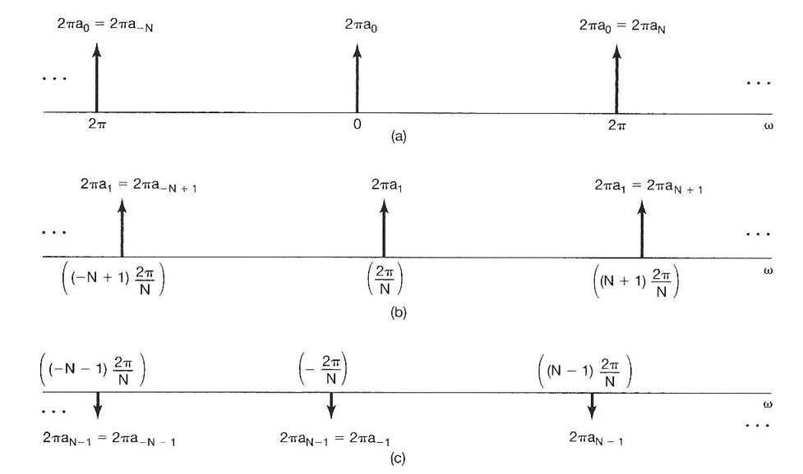







Fourier Transform of Periodic Signal
$$X\left(e^{jω}\right)=\sum_{k=\left\langle N\right\rangle }{a_{k}\sum_{l=−∞}^{∞}{2πδ\left(ω−kω_{0}−2πl\right)}}$$
$$(−N+1)ω_{0}$$
$$ω_{0}$$
$$(N+1)ω_{0}$$
$$(−N−1)ω_{0}$$
$$−ω_{0}$$
$$(N−1)ω_{0}$$

Slide 27
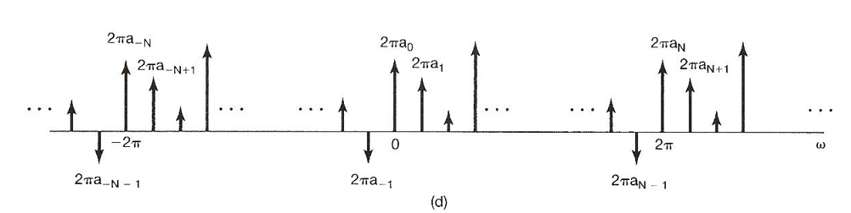

Fourier Transform of Periodic Signal
$$X\left(e^{jω}\right)=\sum_{k=\left\langle N\right\rangle }{a_{k}\sum_{l=−∞}^{∞}{2πδ\left(ω−kω_{0}−2πl\right)}}$$
$$X\left(e^{jω}\right)=\sum_{k=−∞}^{∞}{2πa_{k}δ\left(ω−kω_{0}\right)}$$

Slide 28
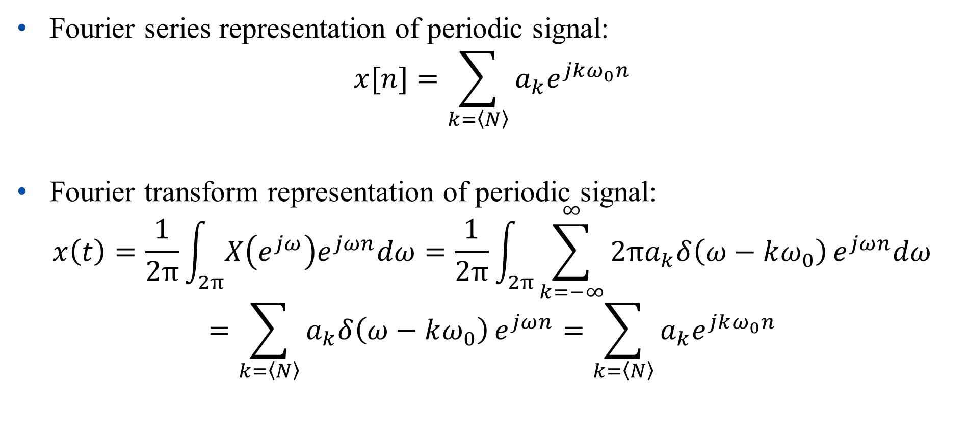
Fourier Transform of Periodic Signal
Fourier series representation of periodic signal:
$$x[n]=\sum_{k=\left\langle N\right\rangle }{a_{k}e^{jkω_{0}n}}$$
Fourier transform representation of periodic signal:
$$x\left(t\right)=\frac{1}{2π}\int_{2π}{X\left(e^{jω}\right)e^{jωn}dω}=\frac{1}{2π}\int_{2π}{\sum_{k=−∞}^{∞}{2πa_{k}δ\left(ω−kω_{0}\right)}e^{jωn}dω}$$
$$=\sum_{k=\left\langle N\right\rangle }{a_{k}δ\left(ω−kω_{0}\right)}e^{jωn}=\sum_{k=\left\langle N\right\rangle }{a_{k}e^{jkω_{0}n}}$$

Slide 29
Fourier Transform of Periodic Signal
Fourier transform can be performed for periodic signals by using impulse function. The spectral is the same as Fourier series.
In such a case, we have a unified framework of Fourier transform for both periodic and aperiodic signals.

Slide 30
Outline: Lecture 8: Discrete-time Fourier Transform
Discrete-time Fourier Transform
Fourier Transform Representation
Fourier Transform of Periodic Signal
Fourier Transform Properties
Examples
Duality

Slide 31

Fourier Transform Properties
The following notation is used to indicate a pair of Fourier transform:
$$x[n]\underset{↔}{F}X(e^{jω})$$

Slide 32

Fourier Transform Properties
Linearity
Assume :
$x[n]\underset{↔}{F}X(e^{jω})$, $y[n]\underset{↔}{F}Y(e^{jω})$
Then:
$ax[n]+by[n]\underset{↔}{F}aX(e^{jω})+bY(e^{jω})$

Slide 33
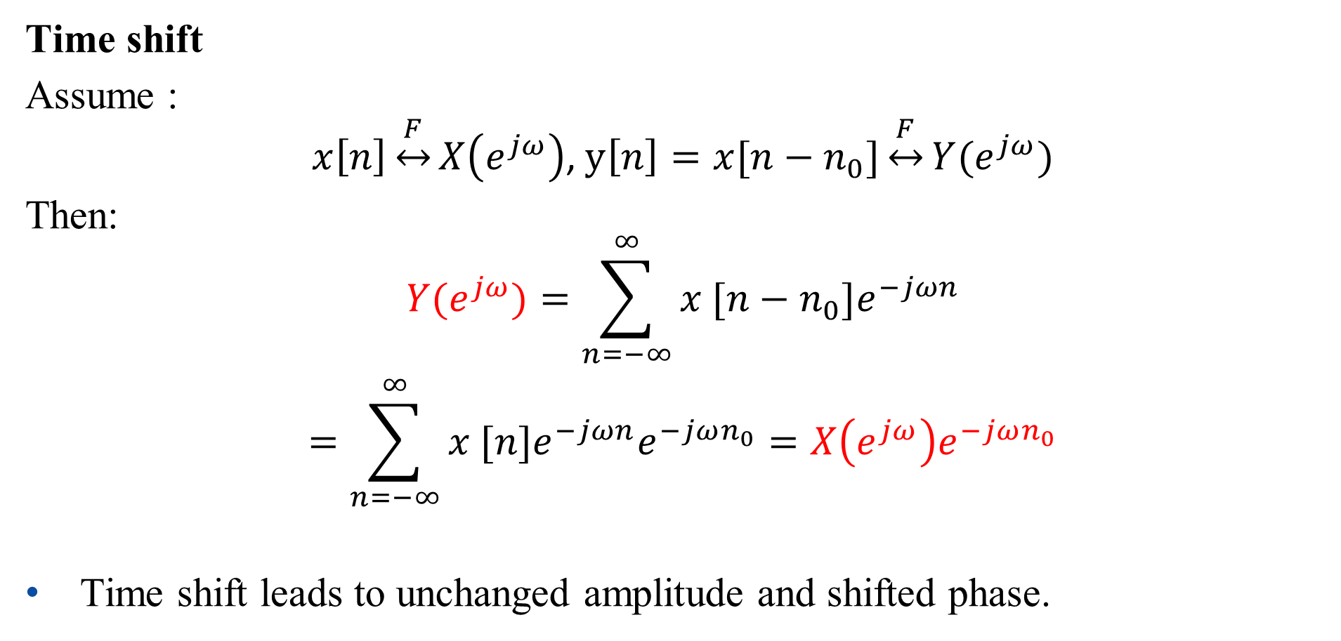
Fourier Transform Properties
Time shift
Assume :
$$x\left[n\right]\underset{↔}{F}X\left(e^{jω}\right)\text{, }y\left[n\right]=x[n−n_{0}]\underset{↔}{F}Y(e^{jω})$$
Then:
$$Y(e^{jω})=\sum_{n=−∞}^{∞}{x [n−n_{0}]e^{−jωn}}$$
$$=\sum_{n=−∞}^{∞}{x [n]e^{−jωn}e^{−jωn_{0}}}=X\left(e^{jω}\right)e^{−jωn_{0}}$$
Time shift leads to unchanged amplitude and shifted phase.

Slide 34
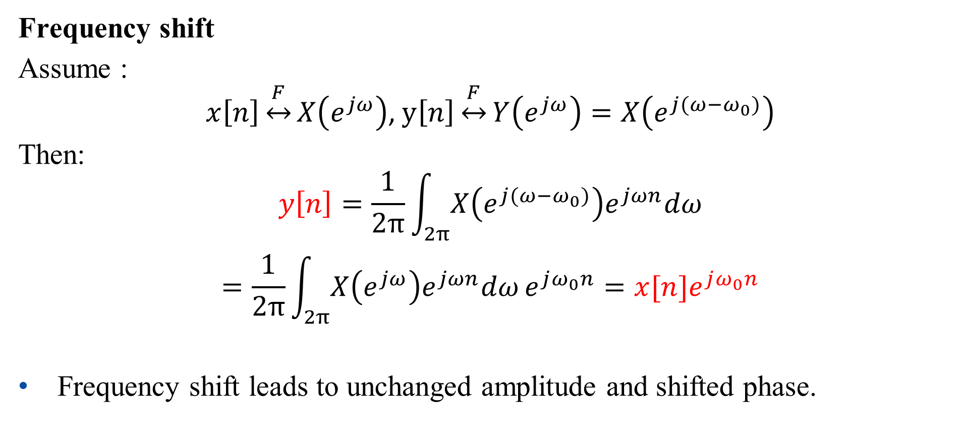
Fourier Transform Properties
Frequency shift
Assume :
$$x\left[n\right]\underset{↔}{F}X\left(e^{jω}\right)\text{, }y\left[n\right]\underset{↔}{F}Y\left(e^{jω}\right)=X\left(e^{j(ω−ω_{0})}\right)$$
Then:
$$y\left[n\right]=\frac{1}{2π}\int_{2π}{X\left(e^{j(ω−ω_{0})}\right)e^{jωn}dω}$$
$$=\frac{1}{2π}\int_{2π}{X\left(e^{jω}\right)e^{jωn}dω}e^{jω_{0}n}=x[n]e^{jω_{0}n}$$
Frequency shift leads to unchanged amplitude and shifted phase.

Slide 35
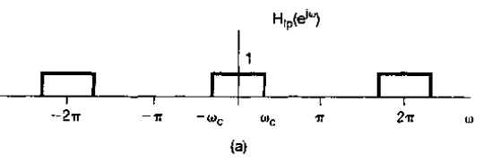
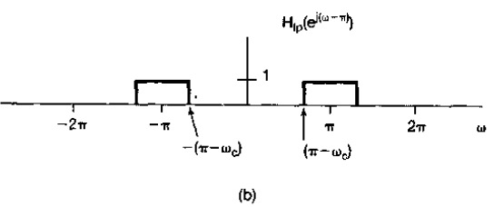

Fourier Transform Properties
Frequency shift
Relationship between low-pass and high-pass filter:
$$H_{hp}\left(e^{jω}\right)=H_{lp}\left(e^{j(ω−π)}\right)$$
$$h_{hp}\left[n\right]=h_{lp}\left[n\right]e^{jπn}={(−1)}^{n}h_{lp}\left[n\right]$$
Low-pass filter:
High-pass filter:

Slide 36
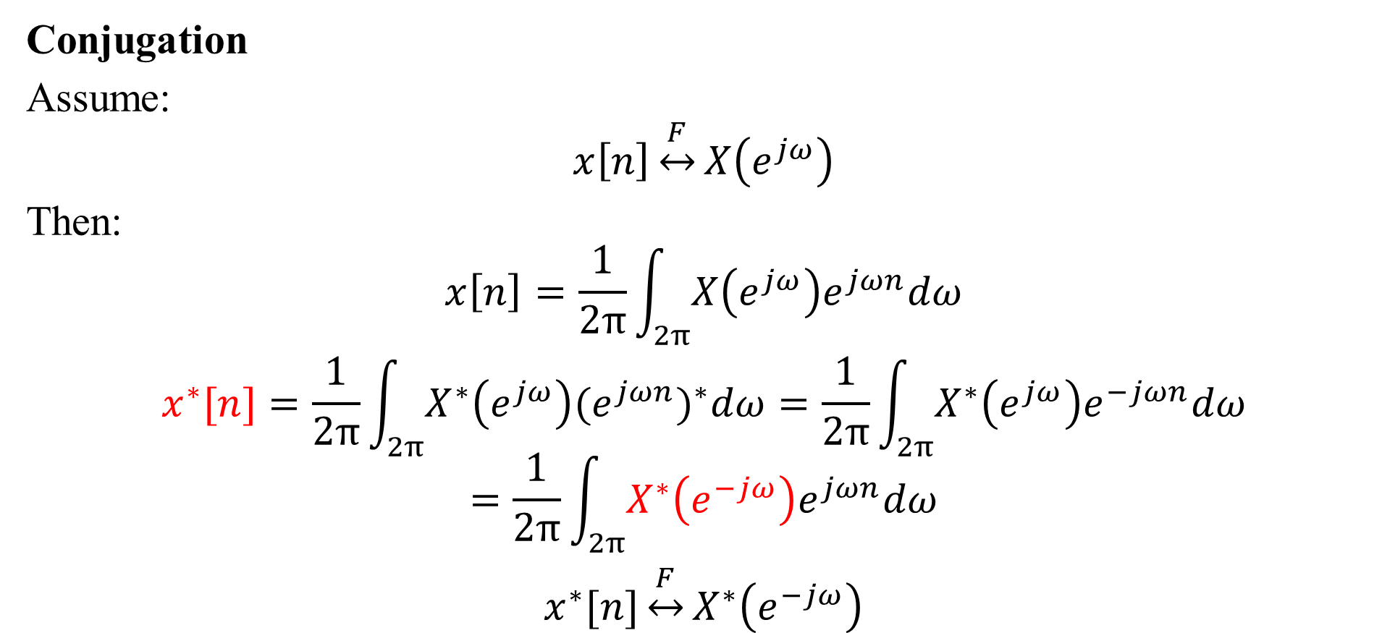
Fourier Transform Properties
Conjugation
Assume:
$$x\left[n\right]\underset{↔}{F}X\left(e^{jω}\right)$$
Then:
$$x\left[n\right]=\frac{1}{2π}\int_{2π}{X\left(e^{jω}\right)e^{jωn}dω}$$
$$x^{∗}[n]=\frac{1}{2π}\int_{2π}{X^{∗}\left(e^{jω}\right){(e^{jωn})}^{∗}dω}=\frac{1}{2π}\int_{2π}{X^{∗}\left(e^{jω}\right)e^{−jωn}dω}=\frac{1}{2π}\int_{2π}{X^{∗}\left(e^{−jω}\right)e^{jωn}dω}$$
$$x^{∗}[n]\underset{↔}{F}X^{∗}\left(e^{−jω}\right)$$

Slide 37

Fourier Transform Properties
Conjugation
Even/Odd property
$$x\left[n\right]\underset{↔}{F}X\left(e^{jω}\right), x^{∗}[n]\underset{↔}{F}X^{∗}\left(e^{−jω}\right)$$
If $x[n]$ is real ($x[n]=x^{∗}[n]$):
$$X\left(e^{jω}\right)=X^{∗}\left(e^{−jω}\right)$$

Slide 38
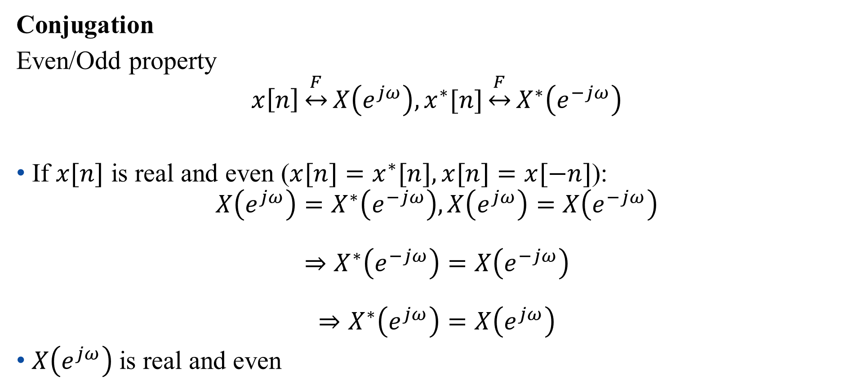
Fourier Transform Properties
Conjugation
Even/Odd property
$$x\left[n\right]\underset{↔}{F}X\left(e^{jω}\right), x^{∗}[n]\underset{↔}{F}X^{∗}\left(e^{−jω}\right)$$
If $x[n]$ is real and even ($x[n]=x^{∗}[n],x[n]=x[−n]$):
$$X\left(e^{jω}\right)=X^{∗}\left(e^{−jω}\right),X\left(e^{jω}\right)=X\left(e^{−jω}\right)$$
$$⇒X^{∗}\left(e^{−jω}\right)=X\left(e^{−jω}\right)$$
$$⇒X^{∗}\left(e^{jω}\right)=X\left(e^{jω}\right)$$
$X\left(e^{jω}\right)$is real and even

Slide 39
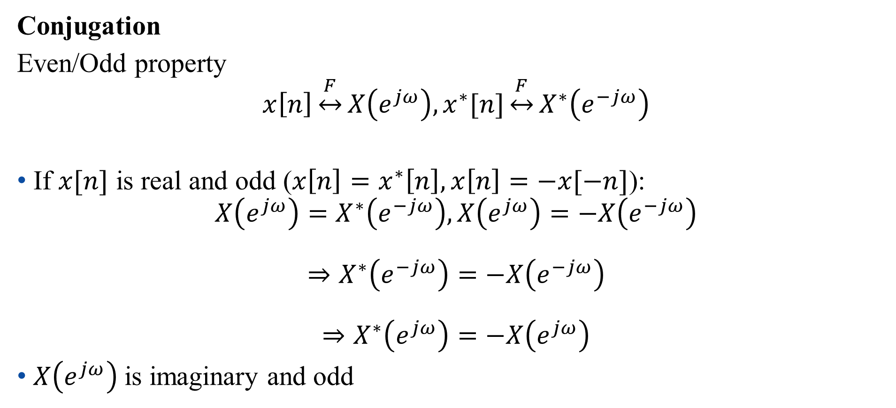
Fourier Transform Properties
Conjugation
Even/Odd property
$$x\left[n\right]\underset{↔}{F}X\left(e^{jω}\right), x^{∗}[n]\underset{↔}{F}X^{∗}\left(e^{−jω}\right)$$
If $x[n]$ is real and odd ($x\left[n\right]=x^{∗}\left[n\right],x\left[n\right]=−x[−n]$):
$$X\left(e^{jω}\right)=X^{∗}\left(e^{−jω}\right),X\left(e^{jω}\right)=−X\left(e^{−jω}\right)$$
$$⇒X^{∗}\left(e^{−jω}\right)=−X\left(e^{−jω}\right)$$
$$⇒X^{∗}\left(e^{jω}\right)=−X\left(e^{jω}\right)$$
$X\left(e^{jω}\right)$is imaginary and odd

Slide 40
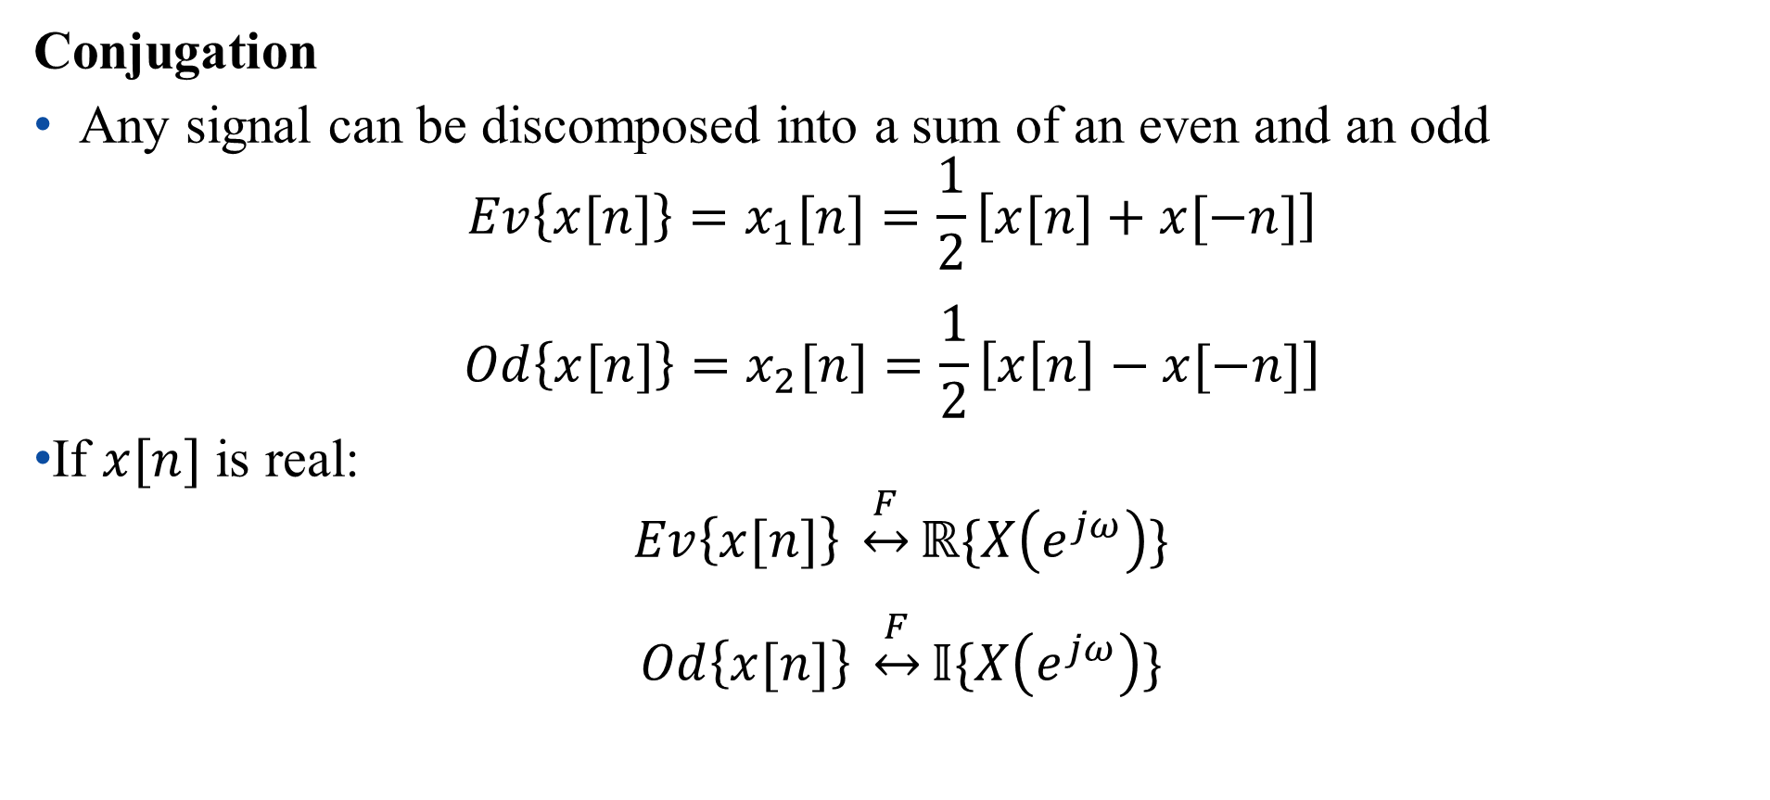
Fourier Transform Properties
Conjugation
Any signal can be discomposed into a sum of an even and an odd
$${Ev\left\{x[n]\right\}=x}_{1}[n]=\frac{1}{2}\left[x[n]+x[−n]\right]$$
$${Od\left\{x[n]\right\}=x}_{2}[n]=\frac{1}{2}\left[x\left[n\right]−x[−n]\right]$$
If $x[n]$ is real:
$$Ev\left\{x[n]\right\} \underset{↔}{F}ℝ\{X\left(e^{jω}\right)\}$$
$$Od\left\{x[n]\right\} \underset{↔}{F}𝕀\{X\left(e^{jω}\right)\}$$

Slide 41
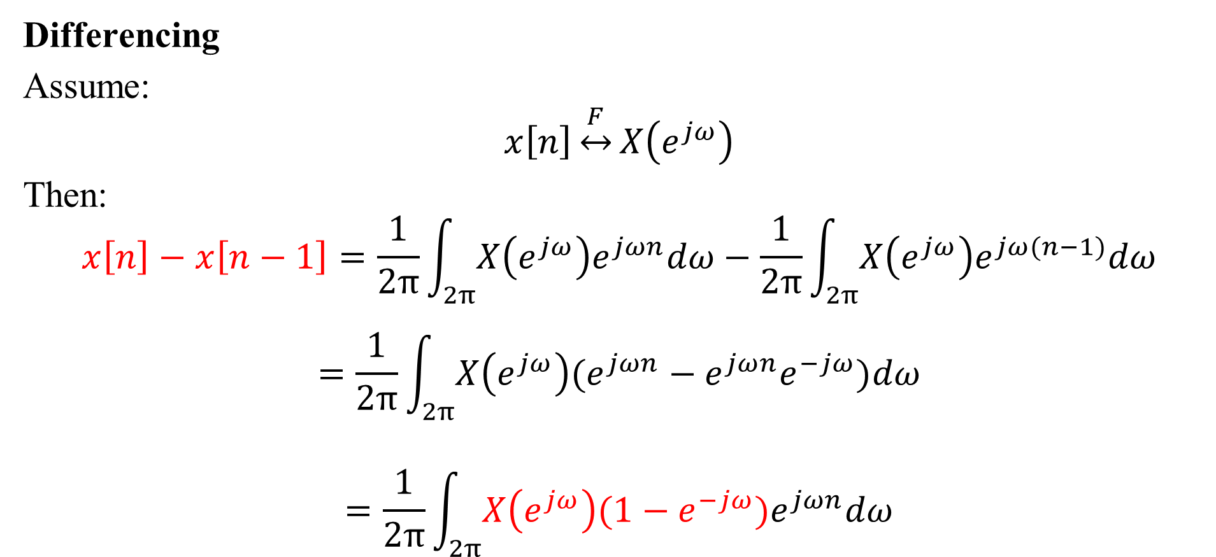
Fourier Transform Properties
Differencing
Assume:
$$x\left[n\right]\underset{↔}{F}X\left(e^{jω}\right)$$
Then:
$$x\left[n\right]−x\left[n−1\right]=\frac{1}{2π}\int_{2π}{X\left(e^{jω}\right)e^{jωn}dω}−\frac{1}{2π}\int_{2π}{X\left(e^{jω}\right)e^{jω(n−1)}dω}$$
$$=\frac{1}{2π}\int_{2π}{X\left(e^{jω}\right)(e^{jωn}−e^{jωn}e^{−jω})dω}$$
$$=\frac{1}{2π}\int_{2π}{X\left(e^{jω}\right)(1−e^{−jω})e^{jωn}dω}$$

Slide 42

Fourier Transform Properties
Accumulation
Assume:
$$x\left[n\right]\underset{↔}{F}X\left(e^{jω}\right)$$
Then:
$$\sum_{m=−∞}^{n}{x\left[m\right]}\underset{↔}{F}\frac{1}{1−e^{−jω}}X\left(e^{jω}\right)+πX(e^{j0})\sum_{k=−∞}^{∞}{δ(ω−2πk) }$$

Slide 43

Fourier Transform Properties
Time reversal
Assume :
$$x[n]\underset{↔}{F}X(e^{jω})$$
Then:
$$x[−n]\underset{↔}{F}X(e^{−jω})$$

Slide 44
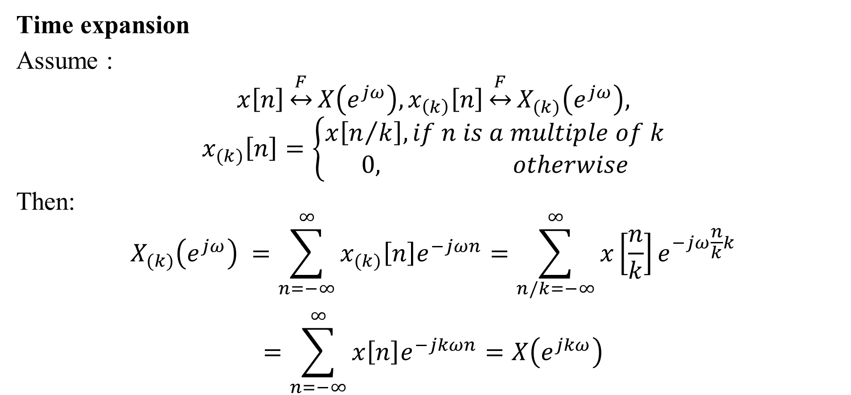
Fourier Transform Properties
Time expansion
Assume :
$$x\left[n\right]\underset{↔}{F}X\left(e^{jω}\right),x_{\left(k\right)}\left[n\right]\underset{↔}{F}X_{(k)}\left(e^{jω}\right),$$
$$x_{(k)}\left[n\right]=\left\{\begin{aligned}x\left[n/k\right], if n is a multiple of k \\ 0, otherwise\end{aligned}\right.$$
Then:
$$X_{(k)}\left(e^{jω}\right) =\sum_{n=−∞}^{∞}{x_{(k)}\left[n\right]e^{−jωn}}=\sum_{n/k=−∞}^{∞}{x\left[\frac{n}{k}\right]e^{−jω\frac{n}{k}k}}$$
$$=\sum_{n=−∞}^{∞}{x\left[n\right]e^{−jkωn}}=X\left(e^{jkω}\right)$$

Slide 45
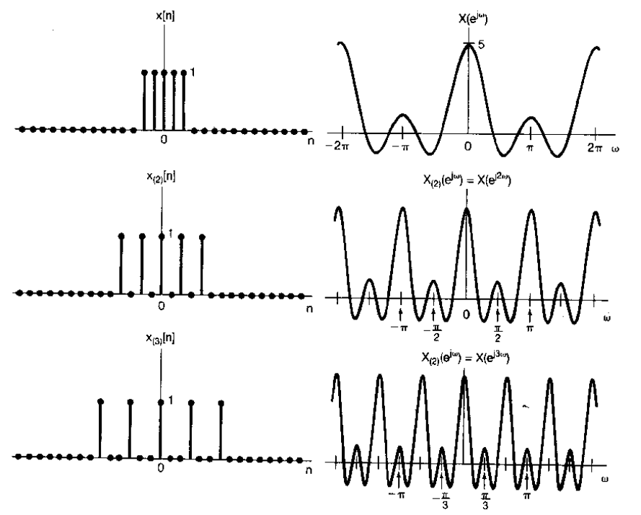
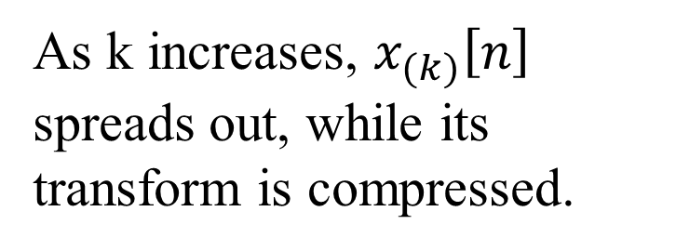
Fourier Transform Properties
Time expansion
As k increases, $x_{(k)}\left[n\right]$ spreads out, while its transform is compressed.

Slide 46

Fourier Transform Properties
Differentiation in frequency domain
Assume :
$$x[n]\underset{↔}{F}X(e^{jω})$$
Then:
$$\frac{dX(e^{jω}) }{dω}=\frac{d\sum_{n=−∞}^{∞}{x [n]e^{−jωn}}}{dω}=\sum_{n=−∞}^{∞}{−jnx [n]e^{−jωn}}$$
$$−jnx\left[n\right]\underset{↔}{F}\frac{dX\left(e^{jω}\right) }{dω},nx\left[n\right]\underset{↔}{F}j\frac{dX\left(e^{jω}\right) }{dω}$$

Slide 47

Fourier Transform Properties
Parseval’s relation
The sum of the square of a function is equal to the integral of the square of its Fourier transform in a period of 2π.
$$\sum_{n=−∞}^{∞}{{|x\left[n\right]|}^{2}}=\frac{1}{2π}\int_{2π}{{|X(e^{jω})|}^{2}dω}$$

Slide 48

Fourier Transform Properties
Parseval’s relation
Proof:
$$\sum_{n=−∞}^{∞}{{|x\left[n\right]|}^{2}}=\sum_{n=−∞}^{∞}{x\left[n\right]x^{∗}[n]}$$
$$=\sum_{n=−∞}^{∞}{x\left[n\right]\frac{1}{2π}\int_{2π}{X^{∗}\left(e^{jω}\right)e^{−jωn}dω}}$$
$$=\frac{1}{2π}\int_{2π}{X^{∗}\left(e^{jω}\right)[\sum_{n=−∞}^{∞}{x\left[n\right]e^{−jωn}}] dω}$$
$$=\frac{1}{2π}\int_{2π}{X^{∗}\left(e^{jω}\right)X\left(e^{jω}\right)dω}=\frac{1}{2π}\int_{2π}{{|X(e^{jω})|}^{2}dω}$$

Slide 49

Fourier Transform Properties
Convolution
Assume :
$$x[n]\underset{↔}{F}X\left(e^{jω}\right), h[n]\underset{↔}{F}H\left(e^{jω}\right)$$
Then:
$$x[n]∗h[n]\underset{↔}{F}X\left(e^{jω}\right)H\left(e^{jω}\right)$$
Proof: similar to continuous-time transformation, p223 of textbook

Slide 50

Fourier Transform Properties
Multiplication
Assume :
$$x_{1}\left[n\right]\underset{↔}{F}X_{1}\left(e^{jω}\right),x_{2}[n]\underset{↔}{F}X_{2}\left(e^{jω}\right)$$
Then:
$$x_{1}\left[n\right]x_{2}\left[n\right]\underset{↔}{F}\frac{1}{2π}\int_{2π}{X_{1}(e^{jθ})X_{2}(e^{j(ω−θ)})dθ}$$
Periodic convolution

Slide 51

Fourier Transform Properties
Multiplication
$$x_{1}\left[n\right]x_{2}\left[n\right]\underset{↔}{F}\frac{1}{2π}\int_{2π}{X_{1}(e^{jθ})X_{2}(e^{j(ω−θ)})dθ}$$
Proof:
$$\sum_{n=−∞}^{∞}{x_{1}[n]x_{2}[n]e^{−jωn}}=\sum_{n=−∞}^{∞}{x_{2}\left[n\right][\frac{1}{2π}\int_{2π}{X_{1}\left(e^{jθ}\right)e^{jθn}dθ}]e^{−jωn}}$$
$$=\frac{1}{2π}\int_{2π}{X_{1}\left(e^{jθ}\right)}\sum_{n=−∞}^{∞}{x_{2}\left[n\right]e^{−j(ω−θ)n}}dθ=\frac{1}{2π}\int_{2π}{X_{1}(e^{jθ})X_{2}(e^{j(ω−θ)})dθ}$$

Slide 52
Outline: Lecture 8: Discrete-time Fourier Transform
Discrete-time Fourier Transform
Fourier Transform Representation
Fourier Transform of Periodic Signal
Fourier Transform Properties
Examples
Duality

Slide 53

Examples
Example 5.2, p.257 of textbook
Find the spectral (Fourier transform) for the following signals: $x\left[n\right]=a^{|n|}, \left|a\right|<1$

Slide 54

Examples
Example 5.2, p.257 of textbook
Find the spectral (Fourier transform) for the following signal: $x\left[n\right]=a^{|n|}, \left|a\right|<1$
$x\left[n\right]=a^{|n|}$ is the even part of $y\left[n\right]=\left\{\begin{aligned}1, n=0 \\ {2a}^{n}u[n]\text{, }\text{n}≠0\end{aligned}\right.$
According to conjugation property:
$$y\left[n\right]=\left\{\begin{aligned}1, n=0 \\ {2a}^{n}u[n]\text{, }\text{n}≠0\end{aligned}\right.\underset{↔}{F}X(e^{jω})$$
$$x\left[n\right]=a^{|n|}\underset{↔}{F}ℝ\{X(e^{jω})\}$$

Slide 55

Examples
Example 5.2, p.257 of textbook
Find the spectral (Fourier transform) for the following signal: $x\left[n\right]=a^{|n|}, \left|a\right|<1$
$$X\left(e^{jω}\right)=y\left[0\right]e^{−jω0}+\sum_{n=1}^{∞}{y[n]e^{−jωn}}=1+\sum_{n=1}^{∞}{{2a}^{n}u[n]e^{−jωn}}$$
$$=1+2\sum_{n=1}^{∞}{({ae^{−jω})}^{n}}=1+2\frac{ae^{−jω}}{1−ae^{−jω}}=\frac{1+ae^{−jω}}{1−ae^{−jω}}$$

Slide 56

Examples
Example 5.2, p.257 of textbook
Find the spectral (Fourier transform) for the following signal: $x\left[n\right]=a^{|n|}, \left|a\right|<1$
$$X\left(e^{jω}\right)=\frac{1+ae^{−jω}}{1−ae^{−jω}}=\frac{1−a^{2}−2jasinω}{1+a^{2}−2cosω}$$
$$x\left[n\right]=a^{|n|}\underset{↔}{F}ℝ\left\{X\left(e^{jω}\right)\right\}=\frac{1−a^{2}}{1+a^{2}−2cosω}$$

Slide 57

Examples
Example 5.13, p.273 of textbook
Compute the time-domain signal for $y\left[n\right]=α^{n}u\left[n\right]∗α^{n}u\left[n\right]$

Slide 58

Examples
Example 5.13, p.273 of textbook
Compute the time-domain signal for $y\left[n\right]=α^{n}u\left[n\right]∗α^{n}u\left[n\right]$
$$α^{n}u\left[n\right]\underset{↔}{F}\frac{1}{1−αe^{−jω}}$$
Based on the convolution property:
$$y\left[n\right]=α^{n}u\left[n\right]∗α^{n}u\left[n\right]\underset{↔}{F}{(\frac{1}{1−αe^{−jω}})}^{2}$$

Slide 59

Examples
Example 5.13, p.273 of textbook
Compute the time-domain signal for $y\left[n\right]=α^{n}u\left[n\right]∗α^{n}u\left[n\right]$
$$α^{n}u\left[n\right]\underset{↔}{F}\frac{1}{1−αe^{−jω}}$$
$$\frac{d}{dω}\left(\frac{1}{1−αe^{−jω}}\right)=−j.−ae^{−jω}.−1.{\left(\frac{1}{1−αe^{−jω}}\right)}^{2}$$
$$⇒ {\left(\frac{1}{1−αe^{−jω}}\right)}^{2}=\frac{j}{a}e^{jω}\frac{d}{dω}\left(\frac{1}{1−αe^{−jω}}\right)$$

Slide 60

Examples
Example 5.13, p.273 of textbook
Compute the time-domain signal for $y\left[n\right]=α^{n}u\left[n\right]∗α^{n}u\left[n\right]$
$$α^{n}u\left[n\right]\underset{↔}{F}\frac{1}{1−αe^{−jω}}$$
According to the property of differencing in frequency domain:
$$nα^{n}u\left[n\right]\underset{↔}{F}j\frac{d}{dω}\left(\frac{1}{1−αe^{−jω}}\right)$$

Slide 61

Examples
Example 5.13, p.273 of textbook
Compute the time-domain signal for $y\left[n\right]=α^{n}u\left[n\right]∗α^{n}u\left[n\right]$
$$nα^{n}u\left[n\right]\underset{↔}{F}j\frac{d}{dω}\left(\frac{1}{1−αe^{−jω}}\right)$$
$${\left(\frac{1}{1−αe^{−jω}}\right)}^{2}=\frac{j}{a}e^{jω}\frac{d}{dω}\left(\frac{1}{1−αe^{−jω}}\right)=\frac{1}{a}e^{jω}\sum_{n=−∞}^{∞}{nα^{n}u\left[n\right]}e^{−jωn}$$
$$=\sum_{n=−∞}^{∞}{nα^{n−1}u\left[n\right]}e^{−jω(n−1)}=\sum_{n=−∞}^{∞}{(n+1)α^{n}u\left[n+1\right]}e^{−jωn}$$

Slide 62

Examples
Example 5.13, p.273 of textbook
Compute the time-domain signal for $y\left[n\right]=α^{n}u\left[n\right]∗α^{n}u\left[n\right]$
$$y\left[n\right]=α^{n}u\left[n\right]∗α^{n}u\left[n\right]\underset{↔}{F}{(\frac{1}{1−αe^{−jω}})}^{2}$$
$${\left(\frac{1}{1−αe^{−jω}}\right)}^{2}=\sum_{n=−∞}^{∞}{(n+1)α^{n}u\left[n+1\right]}e^{−jωn}$$
$$⇒ y\left[n\right]=α^{n}u\left[n\right]∗α^{n}u\left[n\right]\underset{↔}{F}(n+1)α^{n}u\left[n+1\right]$$

Slide 63
Outline: Lecture 8: Discrete-time Fourier Transform
Discrete-time Fourier Transform
Fourier Transform Representation
Fourier Transform of Periodic Signal
Fourier Transform Properties
Examples
Duality

Slide 64

Duality
Fourier transform (spectral):
$$X\left(e^{jω}\right)=\sum_{n=−∞}^{∞}{x [n]e^{−jωn}}$$
Inverse Fourier transform (signal representation):
$$x[n]=\frac{1}{2π}\int_{2π}{X\left(e^{jω}\right)e^{jωn}dω}$$
There is no duality between Fourier transform and inverse transform for discrete-time aperiodic signal.

Slide 65

Duality
Discrete-time Fourier series representation:
$$x\left[n\right]=\sum_{k=\left\langle N\right\rangle }{a_{k}e^{jkω_{0}n}}$$
Discrete-time Fourier series coefficient:
$$a_{k}=\frac{1}{N}\sum_{n=\left\langle N\right\rangle }{x[n]e^{−jkω_{0}n}}$$
But there is a duality between Fourier series and time-domain signal for discrete-time periodic signal.

Slide 66

Duality
Discrete-time Fourier series duality
Assume
$$f[m]=\frac{1}{N}\sum_{r=\left\langle N\right\rangle }{g[r]e^{−jmω_{0}r}}$$
Replace $m, r$ by $k, n$ respectively:
$$f[k]=\frac{1}{N}\sum_{n=\left\langle N\right\rangle }{g[n]e^{−jkω_{0}n}}$$
$$g\left[n\right]\underset{↔}{FS}f[k]$$

Slide 67

Duality
Discrete-time Fourier series duality
Assume
$$f[m]=\frac{1}{N}\sum_{r=\left\langle N\right\rangle }{g[r]e^{−jmω_{0}r}}$$
Replace $m, r$ by $n, −k$ respectively:
$$f[n]=\frac{1}{N}\sum_{k=\left\langle N\right\rangle }{g[−k]e^{jkω_{0}n}}$$
$$f\left[n\right]\underset{↔}{FS}\frac{1}{N}g[−k]$$

Slide 68

Duality
Discrete-time Fourier series duality
If g[n] has a Fourier series f[k], then if we form a new function of time that has the functional form of the series, f[n], it will have a Fourier series g[k] that has the functional form of the original time function (but is a function of frequency).
Mathematically, we can write:
$$g\left[n\right]\underset{↔}{FS}f[k]$$
$$f[n]\underset{↔}{FS}\frac{1}{N}g[−k]$$

Slide 69

Duality
Discrete-time Fourier series duality
Example: Given the following pair of Fourier series representation:
$$x[n]=\left\{\begin{aligned}1, \left|n\right|≤2 \\ 0, 2<\left|n\right|≤4\end{aligned}\underset{↔}{FS}a_{k}=\left\{\begin{aligned}\frac{1}{9}\frac{sin⁡(5πk/9)}{sin⁡(πk/9)}, k is mulptiple of 9 \\ \frac{5}{9}, k is not multiple of 9\end{aligned}\right. \right.$$
Find Fourier series coefficients for $x[n]=\left\{\begin{aligned}\frac{1}{9}\frac{sin⁡(5πn/9)}{sin⁡(πn/9)}, k is mulptiple of 9 \\ \frac{5}{9}, k is not multiple of 9\end{aligned}\right.$

Slide 70

Duality
Discrete-time Fourier series duality
$$x[n]=\left\{\begin{aligned}\frac{1}{9}\frac{sin⁡(5πn/9)}{sin⁡(πn/9)}, k is mulptiple of 9 \\ \frac{5}{9}, k is not multiple of 9\end{aligned}\right.\underset{↔}{FS}a_{k}=\left\{\begin{aligned}\frac{1}{9}, \left|k\right|≤2 \\ 0, 2<\left|k\right|≤4\end{aligned}\right.$$

Slide 71


Duality
Discrete-time Fourier transform
Fourier transform (spectral):
$$X\left(e^{jω}\right)=\sum_{n=−∞}^{∞}{x [n]e^{−jωn}}$$
Inverse Fourier transform (signal representation):
$$x[n]=\frac{1}{2π}\int_{2π}{X\left(e^{jω}\right)e^{jωn}dω}$$
Continuous-time Fourier series
Fourier series representation:
$$x\left(t\right)=\sum_{k=−∞}^{∞}{a_{k}e^{jkω_{0}t}}$$
Fourier series coefficient:
$$a_{k}=\frac{1}{T}\int_{0}^{T}{x\left(t\right)e^{−jkω_{0}t}dt}$$
Duality between discrete-time Fourier transform and continuous-time Fourier series

Slide 72

Duality
Discrete-time Fourier series duality
Example: Given the following pair of Fourier series representation:
$$x(t)=\left\{\begin{aligned}1, \left|t\right|≤T_{1} \\ 0, T_{1}<\left|t\right|≤π\end{aligned}\underset{↔}{FS}a_{k}=\frac{sin⁡(kT_{1})}{kπ} \right.$$
Find Fourier transform for $x[n]=\frac{sin⁡(πn/2)}{πn}$

Slide 73

Duality
Discrete-time Fourier series duality
Fourier series coefficient:
$$\frac{sin⁡(kT_{1})}{kπ} =\frac{1}{T}\int_{0}^{T}{x\left(t\right)e^{−jkω_{0}t}dt},$$
$$x\left(t\right)=\left\{\begin{aligned}1, \left|t\right|≤T_{1} \\ 0, T_{1}<\left|t\right|≤π\end{aligned}\right., T=2π$$
Inverse Fourier transform (signal representation):
$$\frac{sin⁡(πn/2)}{πn} =\frac{1}{2π}\int_{2π}{X\left(e^{jω}\right)e^{jωn}dω}$$
$$⇒ X\left(e^{jω}\right) =\left\{\begin{aligned}1, \left|ω\right|≤π/2 \\ 0, π/2<\left|ω\right|≤π\end{aligned}\right.$$

Slide 74

Duality
$$n$$

Slide 75




Summary
Periodicity
Periodic
Aperiodic
Fourier series
$$x(t)\underset{↔}{FS}a_{k}$$
Fourier transform
$$x(t)\underset{↔}{F}X(jω)$$
Continuous
Periodic in time domain
Discrete in frequency domain
Continuity
Fourier series
$$x[n]\underset{↔}{FS}a_{k}$$
Fourier transform
$$x[n]\underset{↔}{F}X(e^{jω})$$
Discrete

Slide 76
Summary
Periodicity
Periodic
Aperiodic
Fourier series
$$x(t)\underset{↔}{FS}a_{k}$$
Fourier transform
$$x(t)\underset{↔}{F}X(jω)$$
Continuous
Aperiodic in time domain
Continuous in frequency domain
Continuity
Fourier series
$$x[n]\underset{↔}{FS}a_{k}$$
Fourier transform
$$x[n]\underset{↔}{F}X(e^{jω})$$
Discrete

Slide 77
Summary
Periodicity
Periodic
Aperiodic
Fourier series
$$x(t)\underset{↔}{FS}a_{k}$$
Fourier transform
$$x(t)\underset{↔}{F}X(jω)$$
Continuous
Continuous in time domain
Aperiodic in frequency domain
Continuity
Fourier series
$$x[n]\underset{↔}{FS}a_{k}$$
Fourier transform
$$x[n]\underset{↔}{F}X(e^{jω})$$
Discrete

Slide 78
Summary
Periodicity
Periodic
Aperiodic
Fourier series
$$x(t)\underset{↔}{FS}a_{k}$$
Fourier transform
$$x(t)\underset{↔}{F}X(jω)$$
Continuous
Discrete in time domain
Periodic in frequency domain
Continuity
Fourier series
$$x[n]\underset{↔}{FS}a_{k}$$
Fourier transform
$$x[n]\underset{↔}{F}X(e^{jω})$$
Discrete

Slide 79
Summary
Periodic in time domain $↔$ Discrete in frequency domain
Aperiodic in time domain $↔$ Continuous in frequency domain
Continuous in time domain $↔$ Aperiodic in frequency domain
Discrete in time domain $↔$ Periodic in frequency domain

Slide 80
Thank you for your listening!

